Slide 1
2013 Voting Statistics
2014 Election Information
Red Knights International Firefighter Motorcycle Club
Thomas L Caisse
Chair – Nominations Committee
24 August 2013

Slide 2
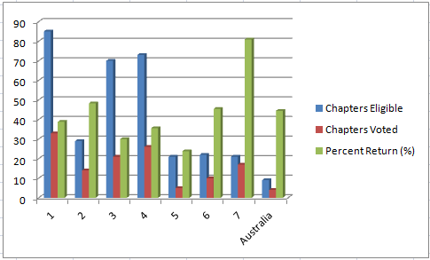
Chapters - 2013

Slide 3
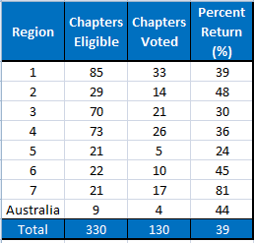
Chapters - 2013

Slide 4
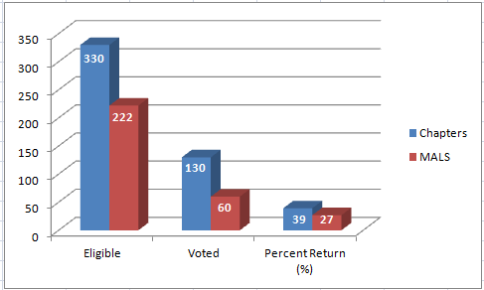
MAL and Chapter Totals 2013

Slide 5
Election 2014 – Offices
Vice President – 2 Year Term
Secretary – 2 Year Term
Region 2 Director – 2 Year Term
Region 4 Director – 2 Year Term
Region 5 Director – 1 Year Term
Region 6 Director – 2 Year Term
Region 7 Director – 1 Year Term

Slide 6
Election 2014 – Key Changes
Section 3:02 Qualification and Election
  Must have served one full term as officer of Chapter Executive Board, State or Provincial Representative or Association Officer.
  Incumbents will be placed on ballot upon formally submitting their intentions to seek re-election prior to the notification dead line for incumbents.
  Note for clarification: If an incumbent misses notification dead line and then decide to seek re-election they will need to follow full nominations process.

Slide 7
Election 2014 – Key Dates
January 20th – Incumbents Intentions Deadline
April 20th – Nominations Close
May 20th – Voting Starts
June 19th – Voting Closes
July 19th – Results Presented at ABM

